Slide 1
Web Application Development
Introduction

Slide 2
outline
Website
Syllabus
Schedule & Canvas
zyBook
What is a web application
What is a web page (HTTP & 3 layers)

Slide 3
Course website
Google “Eric Breimer”
Click on 1st link
Clink on CSIS-390
Or go to: http://breimer.sienacs.com/courses/csis-390-s19/

Slide 4
syllabus
Highlights
20% zyBook reading due Friday and then every Monday evening
20% lab penalty, 100% penalty if not done before lab
15% Lab assignments (1.25%)
20% 4 projects (3%, 4%, 6%, 7%)
Two exams are worth 45%

Slide 5
schedule
Single source for all deadlines and course content.
http://breimer.sienacs.com/courses/csis-390-s19/schedule.php
Canvas is only used for grades and submitting stuff
But, most stuff is submitted by publishing online

Slide 6
zybook
https://learn.zybooks.com
Sign up
Enter code: SIENACSIS390BreimerSpring2019
The cost to subscribe is $58 and subscriptions will be valid through 06/14/19.

Slide 7
What is a web application
Very different Examples
Facebook
Amazon
.io games
cal.sienacs.com

Slide 8
HTTP (Hypertext Transfer Protocol)
Set of rules for transferring files (text, graphic images, sound, video, and other multimedia files) on the World Wide Web.
Website are more than just HTML documents

Slide 9
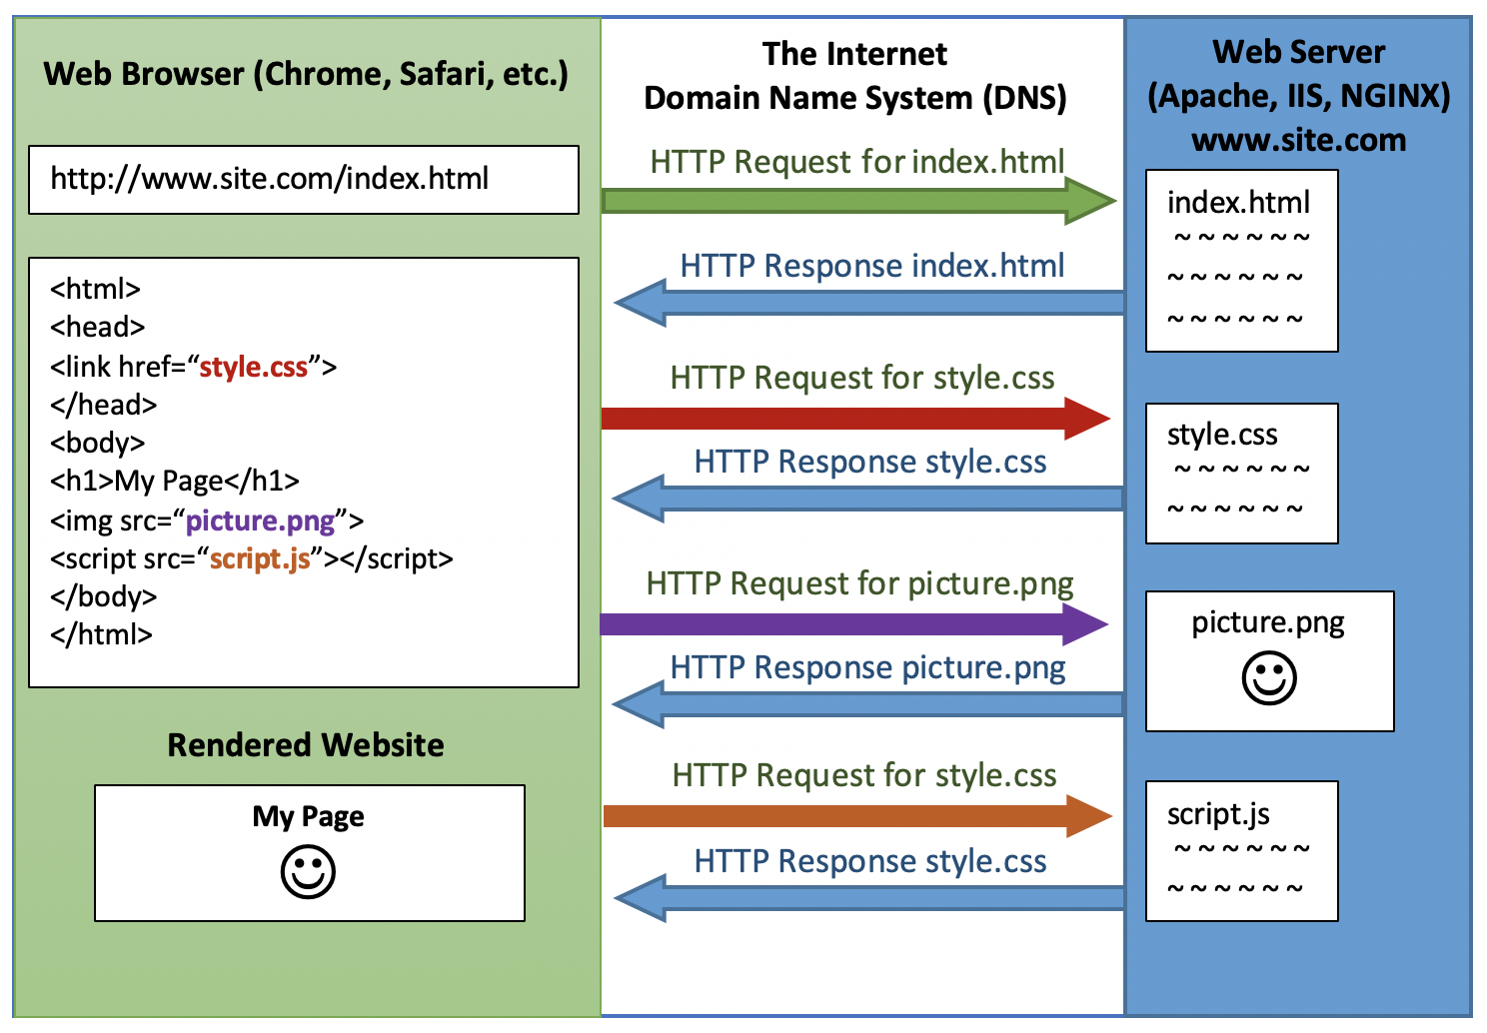

Slide 10
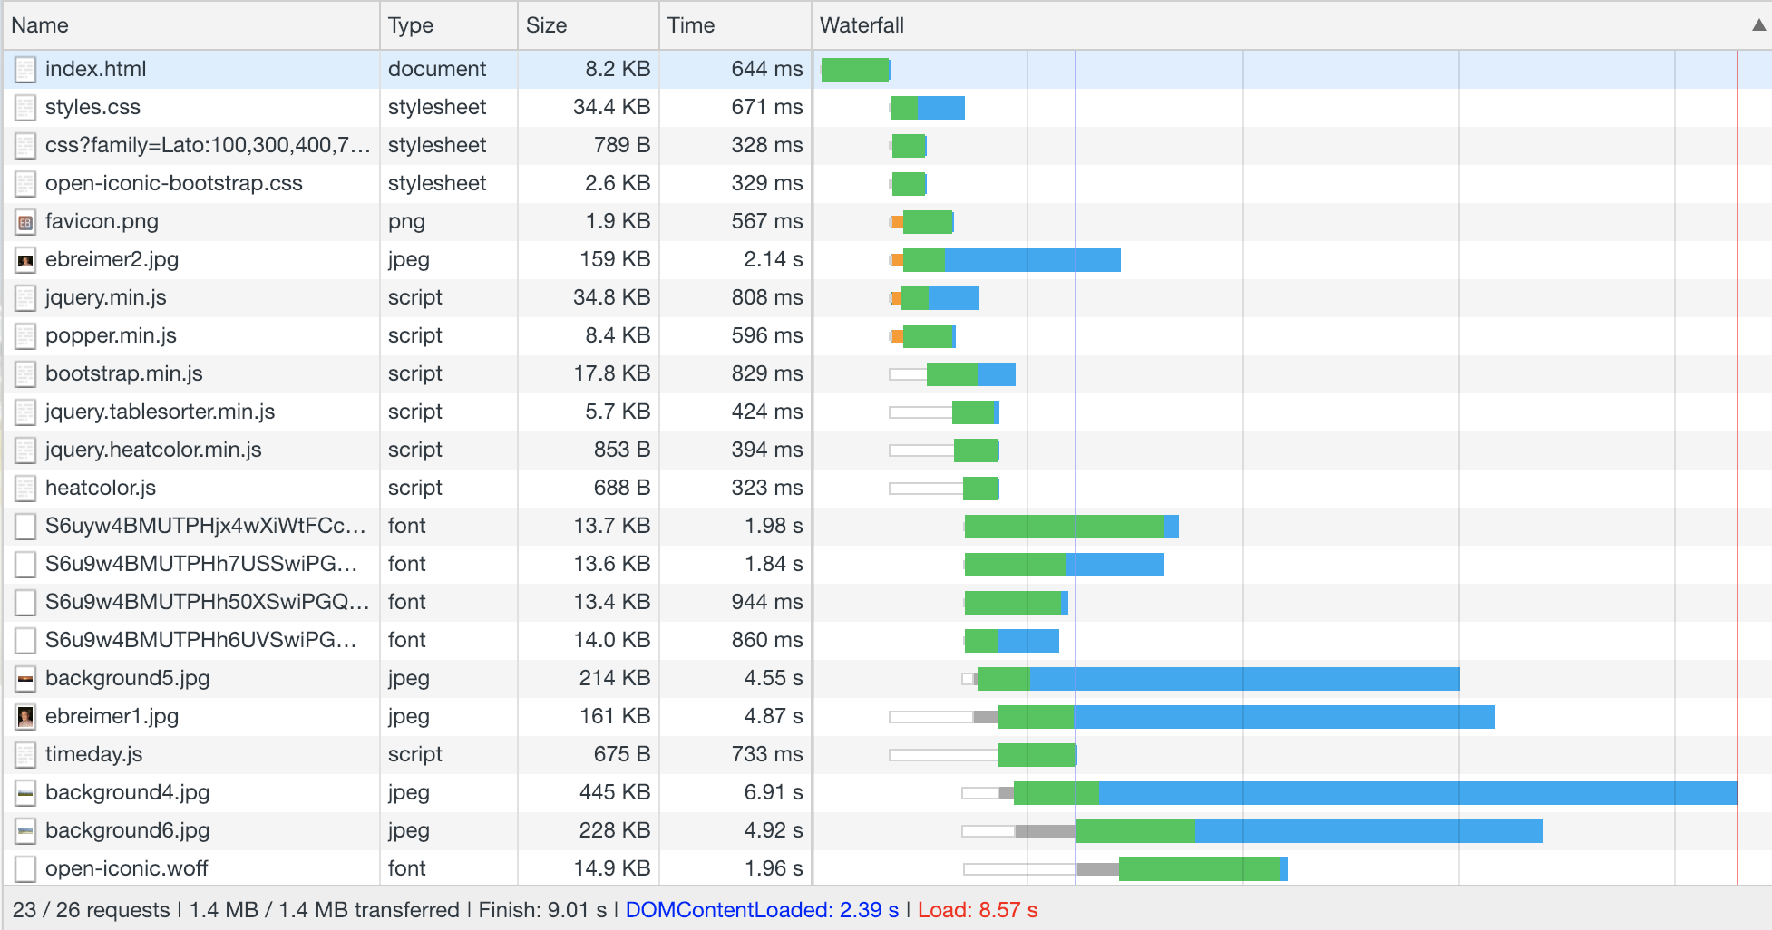

Slide 11
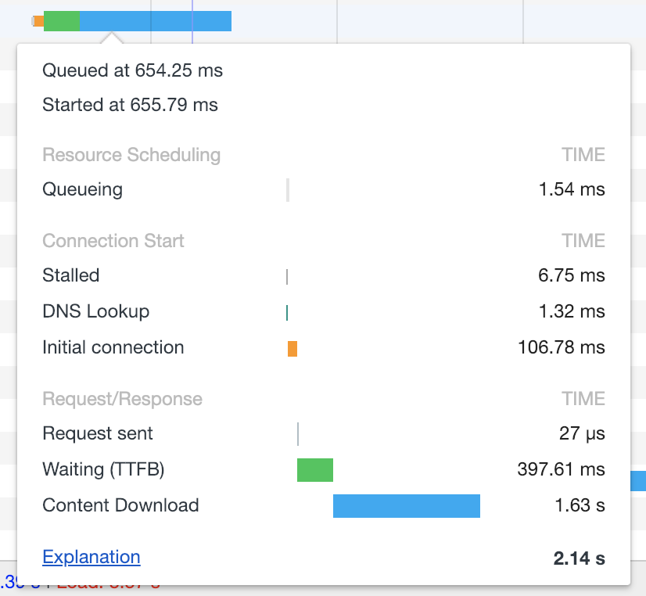

Slide 12
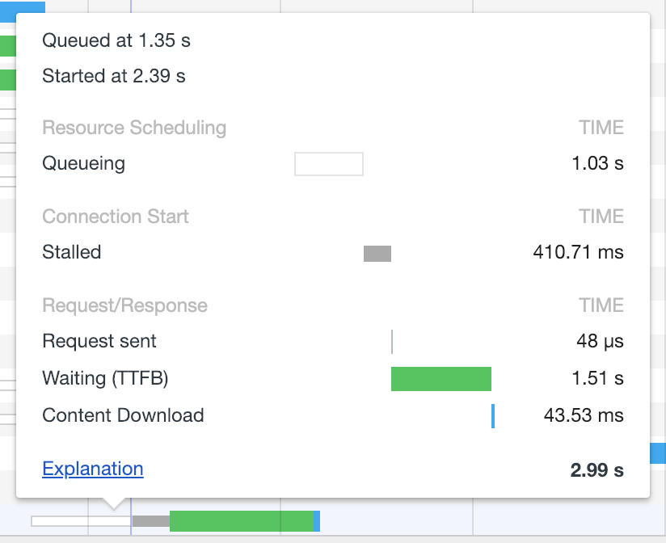

Slide 13
Things to do
zyBook
Chapter 1 (Intro) due Friday night
Chapter 2 (HTML Basics) due Monday night

